Slide 1

Music genre classification
Monisha Siddananda Sampath
Neha Damele
Praveen Raj Veluswami

Slide 2
Problem: Music Genre Classification
Machine learning in music has been in market for a long time.
Experts have been trying for a long time to understand sound and what differentiates one song from another.
Several startups have been ventured to create AI powered personalized audio tracks.
Big companies like Warner Bros, Sony, Google have been showing interest in AI powered music and been actively investing in it.
This project focuses on analyzing music, classifying it.

Slide 3
Data and features
The dataset contains 10 genres each of which has 100 audio files of length 30 seconds.
The following are the audio genres: Blues, Classical, Country, Jazz, Hiphop, Metal, Reage, Pop, Disco and Rock
The following features are extracted,
Chroma_stft, Spectral_centroid, Zero_crossing_rate, Harmony, Perceptr, Tempo, Mfcc, RMS
Each feature has different sub features like mean, standard deviation etc.

Slide 4
Project Roadmap
Exploratory Data Analysis
Preprocessing data
Models
Baseline
Feature Selection
Hyperparameter tuning
Performance
Learnings
Future work

Slide 5
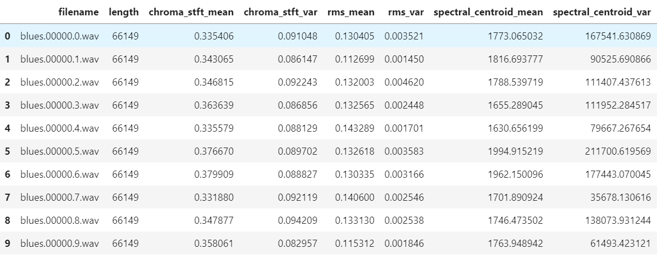
Snapshot of dataset

Slide 6
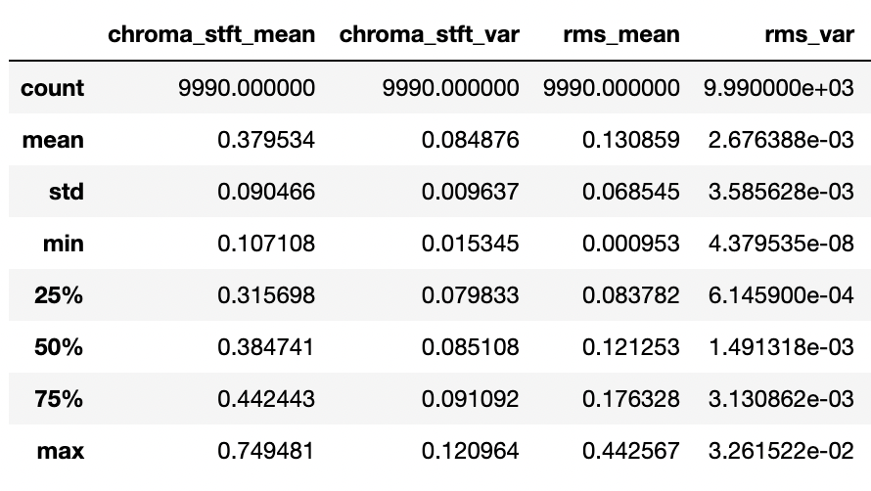
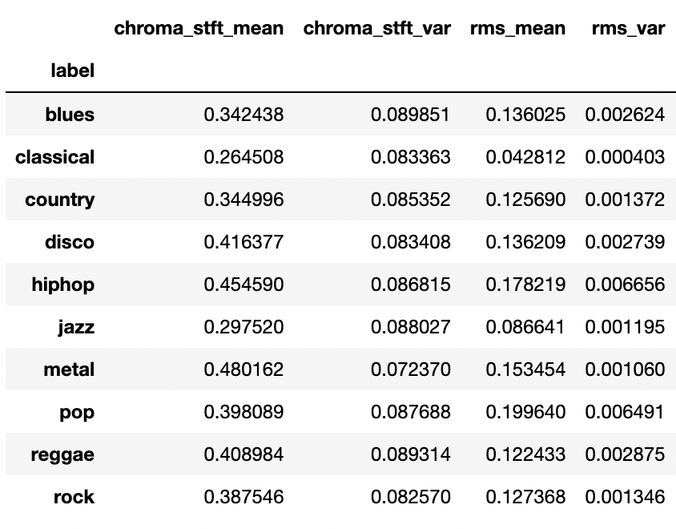
Exploratory Data Analysis
Descriptive statistics
Grouping data
Correlation methods : Correlation coefficient between mfcc1_mean and mfcc2_mean is (-0.6)
Null value or invalid value inspection : No null/invalid values were found

Slide 7
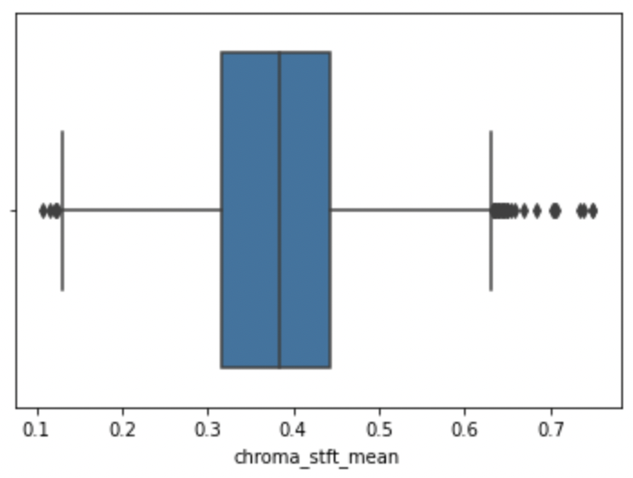
Preprocessing
Duplicate rows
143 rows with identical values were removed resulting in 9847 rows
Standardization
Dataset is normalized using MinMax scaling
Outliers
Outliers were first visualized using boxplots from seaborn library.
For each feature, the interquartile range was computed and values lower than the lower whisker was replaced with the lower whisker and values higher than the upper whisker were replaced with the upper whisker.
Outlier box-plot for chroma_stft_mean

Slide 8
Models
The different models we are using with this dataset:
Random Forest
KNN
Gaussian Naive Bayes
SVM
Logistic Regression
Decision Tree
XGB
OneVsAll
AdaBoost
Ridge

Slide 9
Baseline Performance
The baseline performance was performed with Random Forest and XGB Classifier. We got accuracy of 85% in Random Forest and 87% in XGB classifier.
The following evaluation metrics were used:
Precision
Accuracy
F1-Score
Confusion matrix

Slide 10
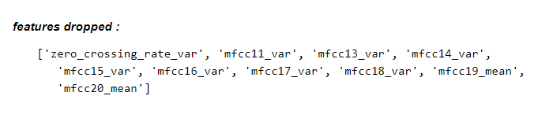
Feature Selection
Performed Feature Selection with Recursive Feature Elimination (RFE) of Sklearn.
Established a base performance with XGBClassifier.
We achieved an accuracy of 0.87. We could do this using all 57 features, which is much more than we might need.
After using RFE for XGBClassifier, discarded the following features for which the .support_ attribute gave a boolean mask with False:
Even after dropping 10 features, we still got an impressive score of 0.89.

Slide 11
Hyperparameter tuning
Hyperparameter tuning helps in determining the optimal tuned parameters and returns the best fit model.
We used hyperopt library to help tune few parameters of XGBoost.
The output is the following :
After hypertuning with the best params given by hyperopt, XGBoost gave .89 accuracy.
Tried tuning an ensemble classifier, Random Forest’s parameters
Accuracy improved slightly from 0.85 to 0.86

Slide 12
Dimensionality reduction using PCA
We tried dimensionality reduction using PCA keeping first few principal components while preserving as much variation as possible.
Observations :
PCA resulted in a lower accuracy score than we obtained before (Random forest : 0.79 ; XGB : 0.72)
We tried PCA on only the similar features in the dataset like mfcc features which resulted in a better performance but still lower than before (Random forest : 0.83 ; XGB : 0.85).
We removed the variance columns and implemented the above two methods but it did not result in a desired score (Random forest : 0.85 ; XGB : 0.87) despite an improvement.

Slide 13
Performance of different classifier
Classifier | Baseline | After Improving
Random Forest | 85 | 86
XGB | 87 | 89

Slide 14
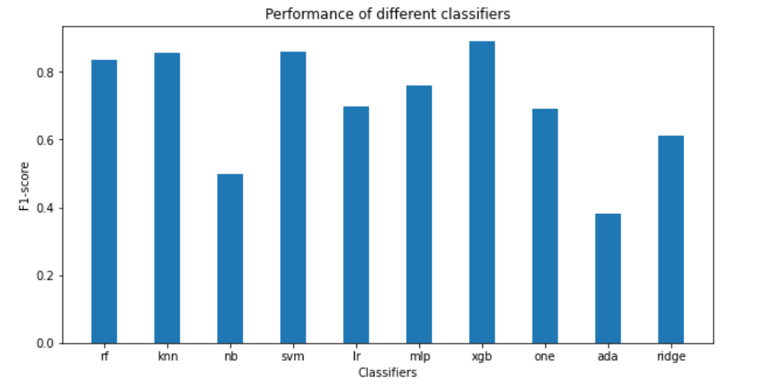
F1 - Score of different classifiers

Slide 15
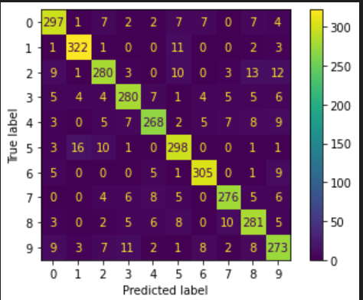
Confusion matrix of XGB Classifier
blues - 0
classical - 1
country - 2
Disco - 3
Hiphop - 4
Jazz - 5
Metal - 6
Pop - 7
Reggae - 8
Rock - 9

Slide 16
Learnings
Can the performance be improved more ?
How Random Forest and XGBClassifiers are so powerful?
Learning about Librosa audio framework.

Slide 17
Future Scope
Classification with multiple labels
Music Recommendation System
Song Generation using GANs
Novelty detection (not belong to any class)
Instrument identification

